Slide 1







Goal:
Take essences from the research tableau until you’ve placed all of one element into your experiments.
Your final setup must follow all alchemical laws
Essences have 2 attributes
ELEMENT: Exactly 13 instances of each element is distributed among the board
Element Types
LETTER: Each essence is randomly generated with a letter A-F,
There is no guaranteed amount for any letter

Slide 2
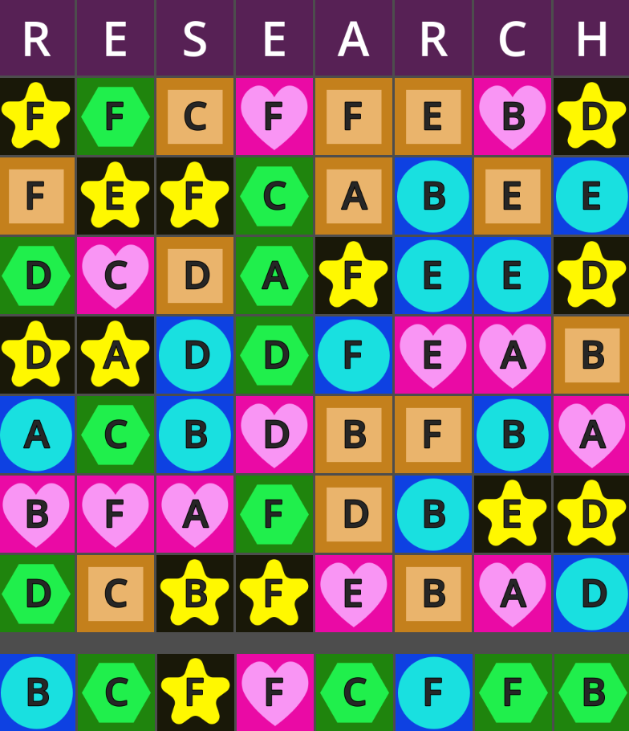

Only the essences in the bottom row are available to take
After taking an essence, it will be replaced by the next one above it in the same column
You can only take from research if all experiments are stable
You can freely move essences between experiments

Slide 3
All active experiments are subject to alchemical laws
Experiments are only active if they have at least 3 essences in them
Inactive experiments are automatically considered stable
Active experiments are stable only if they do not violate any alchemical laws
The laws of Alchemy apply separately to both elements and letters
Alchemy law #1
Alchemy law #2
(anti-equality rule)
An experiment can not have an equal count of two different elements
An experiment can not have an equal count of two different letters
(anti-majority rule)
An experiment can not have more of any element than all its other elements combined
An experiment can not have more of any letter than all its other letters combined

Slide 4
Meta Constraints
Eventually, both alchemical laws will also apply to the number of essences each active experiment has
In other words, two active experiments can not have the same number of essences and one experiment can not have more essences than all the other active experiments combined
These constraints do not apply until there are at least 20 essences in your active experiments
When meta constraints are broken, all experiments become unstable

Slide 5
Storage
Essences can be freely placed in or out of storage.
Storage is never subject to alchemic laws and its contents do not contribute towards victory
Storage has a capacity of 8
Storage starts with 1 random essence
Controls
Scroll wheel to move the screen up or down
Drag and drop essences to their destination
(Alternate control: using the 1,2,3,4,5 and space (storage) keys to select an experiment and click on an essence to send it there
Ctrl + and Ctrl – zooms in and out (probably unnecessary, it’s more a failsafe incase I messed up UI scaling)

